Slide 1

SPECIAL PROJECT - I
Voice assistant for PC Management
BY
Tarun A(20STUCHH010130)
Pawan Kalyan(20STUCHH010020

Slide 2
OVERVIEW
Using Python to create a voice assistant script.
Input voice is used in this project to render speech output and display text on the screen. Our fundamental goal with voice assistance is to use a computer to make people smarter and get outcomes more quickly. Voice Help uses our microphone to record voice input and translates it into comprehensible computer language, providing the user with the answers and solutions they need. To deliver the results the user has requested, this service is connected to the World Wide Web. Computer systems can communicate in a variety of ways utilising natural human language thanks to the Natural Language Processing algorithm

Slide 3


SOFTWARE’S USED
Python
PyQT

Slide 4
Tasks which can perfrom by voice assistant
opening google
opening youtube
telling time
searching wikipedia
Locking the window
playing music
Best Restaurants

Slide 5
Python code
Modules imported
from PyQt5 import QtWidgets, QtGui,QtCore
from PyQt5.QtGui import QMovie
import sys
from PyQt5.QtWidgets import *
from PyQt5.QtCore import *
from PyQt5.QtGui import *
from PyQt5.uic import loadUiType
import pyttsx3
import speech_recognition as sr
import os
import time
import webbrowser
import datetime
import ctypes
import wikipedia
import subprocess
Voices of assistant
engine = pyttsx3.init('sapi5')
voices = engine.getProperty('voices')
engine.setProperty('voice',voices[0].id)
engine.setProperty('rate',180)
assistant to speak and greet
def speak(audio):
engine.say(audio)
engine.runAndWait()
def wish():
hour = int(datetime.datetime.now().hour)
if hour>=0 and hour <12:
speak("Good morning")
elif hour>=12 and hour<18:
speak("Good Afternoon")
else:
speak("Good night")

Slide 6
main body
Sample commands code given to assistant
def JARVIS(self):
wish()
while True:
self.query = self.STT()
if 'good bye' in self.query:
sys.exit()
elif 'open google' in self.query:
webbrowser.open('www.google.co.in')
speak("opening google")
elif 'open youtube' in self.query:
webbrowser.open("www.youtube.com")
elif 'play music' in self.query:
speak("playing music from pc")
self.music_dir ="./music"
self.musics = os.listdir(self.music_dir)
elif "best restaurant" in self.query:
speak(" searching results")
webbrowser.open("https://www.google.com/search?q=best+restaurants+near+me&rlz=1C1CHBF_enIN1025IN1025&oq=best+re&aqs=chrome.1.69i57j0i271l3.2874j0j7&sourceid=chrome&ie=UTF-8")
assistant to wake,listen and recognize user’s voice
def run(self):
self.JARVIS()
def STT(self):
R = sr.Recognizer()
with sr.Microphone() as source:
print("Listening...........")
audio = R.listen(source)
try:
print("Recog......")
text = R.recognize_google(audio,language='en-in')
print(">> ",text)
except Exception:
speak("Sorry Speak Again")
return "None"
text = text.lower()
return text

Slide 7
GUI CODE
FROM_MAIN,_ = loadUiType(os.path.join(os.path.dirname(__file__),"./scifi.ui"))
class Main(QMainWindow,FROM_MAIN):
def __init__(self,parent=None):
super(Main,self).__init__(parent)
self.setupUi(self)
self.setFixedSize(1920,1080)
self.label_7 = QLabel
self.exitB.setStyleSheet("background-image:url(./lib/exit - Copy.png);\n"
"border:none;")
self.exitB.clicked.connect(self.close)
self.setWindowFlags(flags)
Dspeak = mainT()
self.label_7 = QMovie("./lib/gifloader.gif", QByteArray(), self)
self.label_7.setCacheMode(QMovie.CacheAll)
self.label_4.setMovie(self.label_7)
self.label_7.start()
self.ts = time.strftime("%A, %d %B")
Dspeak.start()
self.label.setPixmap(QPixmap("./lib/tuse.png"))
self.label_5.setText("<font size=8 color='white'>"+self.ts+"</font>")
self.label_5.setFont(QFont(QFont('Acens',8)))
app = QtWidgets.QApplication(sys.argv)
main = Main()
main.show()
exit(app.exec_())

Slide 8
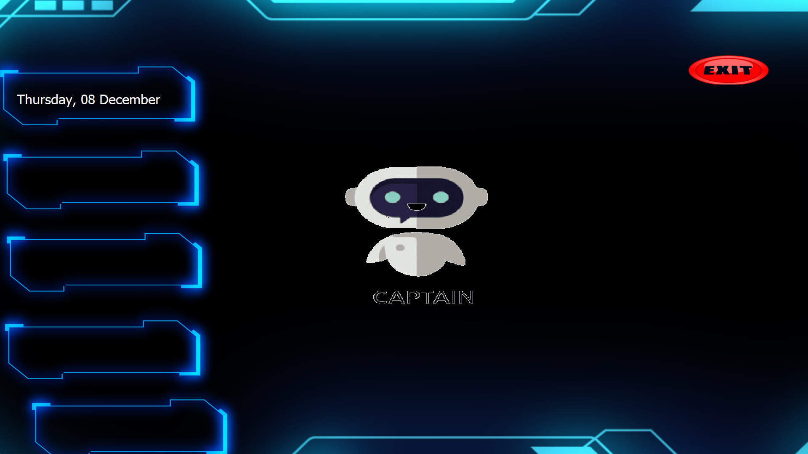
voice assistants GUI

Slide 9
THANK YOU！

